Slide 1
Committee Meeting
Minzhe Zhang
Integrative Biology Graduate Program
Mentors: Dr. Yang Xie & Dr. Guanghua Xiao
Committee Members: Dr. Joshua Mendell
Dr. Xiaowei Zhan
Dr. Deepak Nijhawan
04/19/1992

Slide 2
Outline
Computational Approach to Predict Multi-Drug Synergistic Effect
Background
IGRE model
Biological validation
Summary and future plan
Bioinformatics Tool to Detect RBP Bound CircRNA in CLIP-Seq Datasets
Background
Motivation
Pipeline
Preliminary results
Future plan

Slide 3
Outline
Computational Approach to Predict Multi-Drug Synergistic Effect
Background
DIGRE model
Biological validation
Summary and future plan
Bioinformatics Tool to Detect RBP Bound CircRNA in CLIP-Seq Datasets
Background
Motivation
Pipeline
Preliminary results
Future plan

Slide 4
Motivation to study multi-drug therapy
Single agent dose not achieve good therapeutic effect in complex disease (such as cancer)
lack of efficacy: various PI3K inhibitors
drug resistance: farnesyltransferase inhibitors
Multi-drug therapy could potential overcome these problems
better therapeutic effect
delayed drug resistance
Vogler, Meike. 2014.
Chapman, Paul B. 2013.
Notes:
Drug synergy is complicated, but why we want synergy?
The answer is simple, because single drug sometimes is not good enough, especially in complex disease like cancer.
There many promising drug candidates in preclinical research perform bad in clinical trials.
E.g. CDK show lack of efficacy in patients, BCL-2 has intolerable toxicity and resistance to farnesyltransferase inhibitors
Having these problems, people are turning to multi-drug therapy which can …

Slide 5
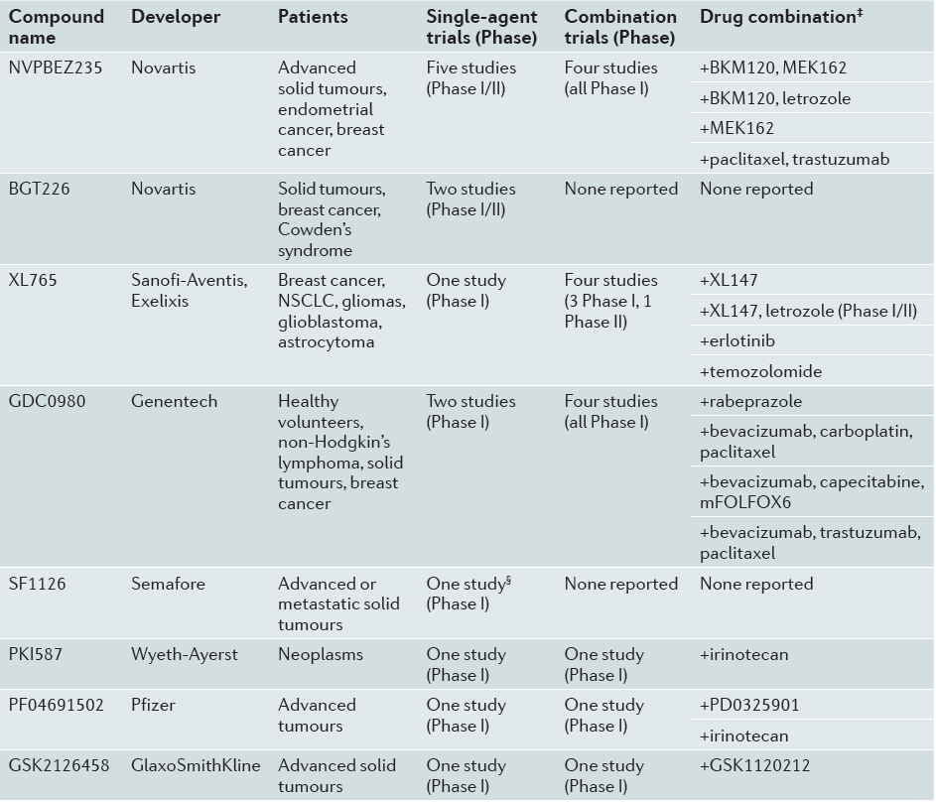
Motivation to study multi-drug therapy
Clinical trial of Dual mTOR/PI3K inhibitors inhibitors in combination with:
MEK/ERK inhibitor
Cytotoxic drug
EGFR/VEGFR inhibitor
HER2 monoantibody
Don Benjamin, et al., 2011
Notes:
Drug synergy is complicated, but why we want synergy?
The answer is simple, because single drug sometimes is not good enough, especially in complex disease like cancer.
There many promising drug candidates in preclinical research perform bad in clinical trials.
E.g. CDK show lack of efficacy in patients, BCL-2 has intolerable toxicity and resistance to farnesyltransferase inhibitors
Having these problems, people are turning to multi-drug therapy which can …

Slide 6
Definition of drug synergy
Bliss assumption on additive: two drug elicit their effect independently
Death
Survival
f_{A}
40%
60%
1 – f_{A} drug A
f_{B}
30%
70%
1 – f_{B} drug B
1 - (1-f_{A})(1-f_{B})
58%
42%
(1-f_{A})(1-f_{B}) Bliss independence
70%
30%
f_{A+B} Synergy
44%
54%
f_{A+B} Antagonism
Notes:
Bliss assume when two drugs …, they should be additive.
E.g. 60% survive after drug A treatment, then .6 time .7, there should be 42% cell survive when we treat cell with both A and B.
This model is straightforward, and easy to calculate, but it has some limitations.
The most important one is it does not…
Intuitively, a drug combined with …,
The reason is this model ignore the dose response curve of two drug, so the calculation will violate the dose response curve when a drug combined with itself.

Slide 7
Quantification of degree of synergy
Death
Survival
1 - (1-f_{A})(1-f_{B})
58%
42%
(1-f_{A})(1-f_{B}) Bliss independence
70%
30%
f_{A+B} Synergy
Δ Excess over bliss (EOB)
Δ = 12%
EOB = f_{A+B} - (1-f_{A})(1-f_{B})
Need to be experimentally determined
Notes:
Bliss assume when two drugs …, they should be additive.
E.g. 60% survive after drug A treatment, then .6 time .7, there should be 42% cell survive when we treat cell with both A and B.
This model is straightforward, and easy to calculate, but it has some limitations.
The most important one is it does not…
Intuitively, a drug combined with …,
The reason is this model ignore the dose response curve of two drug, so the calculation will violate the dose response curve when a drug combined with itself.

Slide 8
Large screening of drug combination
# of possible pairs increase exponentially
Low discovery rate of synergistic pair
Screening experiments show that only 4-10% drug pairs are synergistic.
in silico screening
Identify promising synergistic pairs, reduce the number of combination to screen
# of drugs | # of pairwise combination | # of triplex combination
10 | 45 | 120
100 | 4,950 | 161,700
1000 | 499,500 | 166,167,000
10000 | 49,995,000 | 166,616,670,000
Notes:
Then we could ask how we could identify synergistic pairs.
Someone may say we can infer based on their MOA, it may …, but in general, inference on MOA would be very hard.
Another approach is high throughput screening. This is wildly used for single drug, but when it comes to multi-drugs, the # of possible combination will increase exponentially. Consider the potential profit we can have, many pharmaceutical company don’t think it’s valuable to conduct large scale screening.
So if we can use computational approach to first

Slide 9
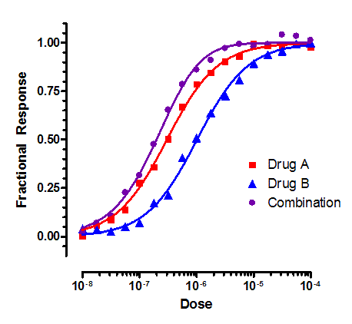
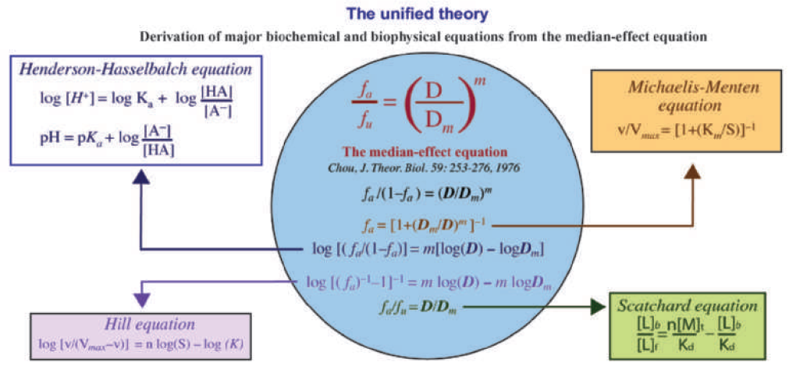
Computational approach
Dose effect methods (Chou-Talalay method)
Kinetics based – median effect & mass action law
Well established in simple scenarios
Simple effect measure – protein inhibition
Simple drug interaction – same target or same reaction
Limitation
Not effective in indirect effect measure – cell death phenotype
Not interpretable in terms of mechanism – synergy occur in system level
Chou, Ting-Chao. 2010.
Notes:
Traditional computational approach is more dose-effect curve oriented. They are kinetics based, derived from …
They use simple effect …, assume simple drug interaction
By doing this simplification, we are able to study some simple synergy, but not …
In reality, what we are more interested is indirect effect
And usually, drug exert synergy through complex protein interaction network.
Now, with –omic data become much more available, we want ask …

Slide 10
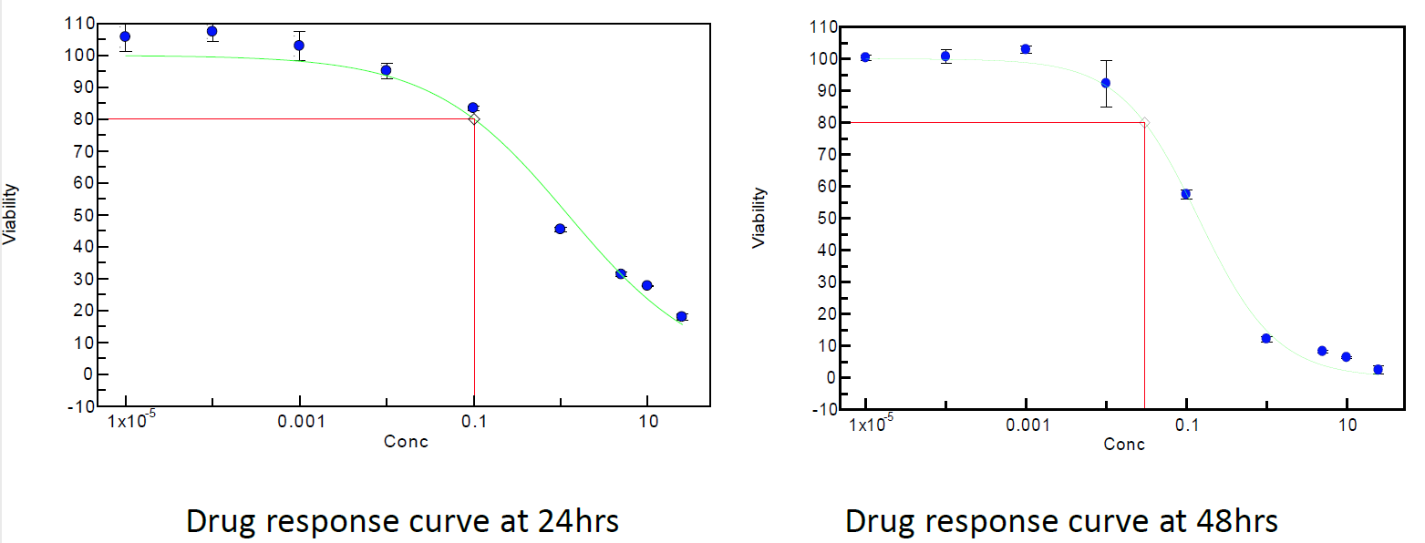
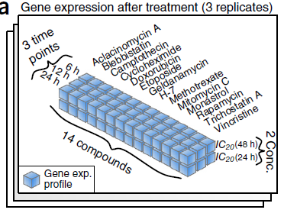
DREAM 7 drug synergy data set
gene expression data
predict the synergistic rank of all the compound pairs
dose response curve
24h DRC
48h DRC
Bansal, Mukesh, et al. 2014.
Notes:
2012, DREAM challenge launched a competition for drug synergy perdition.
This dataset contains 14 drugs, for each drug, GEP were measured in 6h, 12h and 24h after drug treatment. And drug was given in two dose …
DRC
With these data, participants were ask to rank all drug pairs from most synergistic to most antagonist.

Slide 11
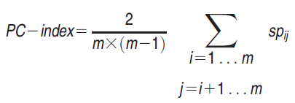
Performance evaluation
Scoring function – PC-index
Predicted
Ground truth
Combination | Predicted Rank | Observed Rank
Doxorubicin & H-7 | 21 | 1
H-7 & Mitomycin C | 3 | 2
Etoposide & Mitomycin C | 5 | 3
Doxorubicin & Mitomycin C | 11 | 4
Camptothecin & Mitomycin C | 7 | 5
Etoposide & H-7 | 9 | 6
Blebbistatin & H-7 | 8 | 7
… | … | …
Blebbistatin & Camptothecin | 42 | 88
Camptothecin & Rapamycin | 28 | 89
Etoposide & Monastrol | 45 | 90
Doxorubicin & Monastrol | 49 | 91
Random guess has PC-index 0.5.
Maximum PC-index is 0.9 because of the noise of the dataset.

Slide 12
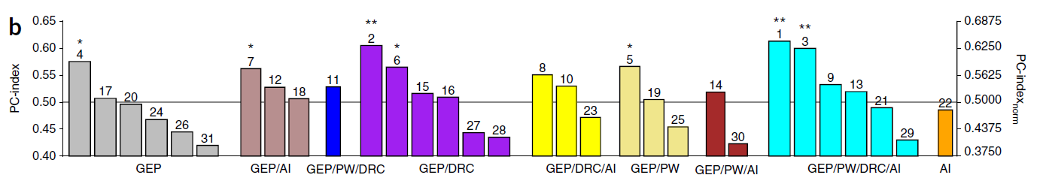
Drug Induced Genomic Residual effect (DIGRE)
DIGRE
PC-index 0.613
p-value < 0.0001

Slide 13
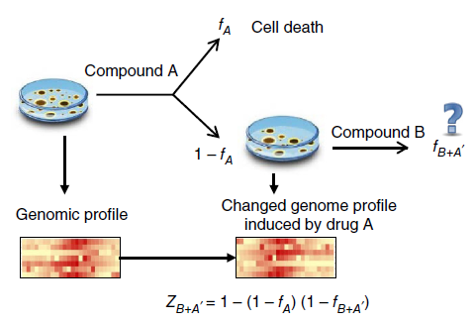
Assumption: sequential drug addition
Approximate drug combination by sequential drug addition
Available data
Need to estimate
Question:
What is the viability reduction of drug B treatment? (drug A has been given first)
Assumption 1:
The genomic change induced by drug A reflect the killing effect of drug A.
Assumption 2:
The genomic change induced by drug A can contribute to the killing effect of drug B.
Question: how to quantify this contribution
Notes:
How DIGRE work?
Because what we have is the single drug treatment data, so we approximate …
Then the question becomes how to estimate the viability reduction if the cell has already been treat …
We have the gene expression profile in baseline and single drug treatment, to use these data, we assume that …
And further we assume that …
Now the question becomes how to quantify the contribution of first drug to the second drug.

Slide 14
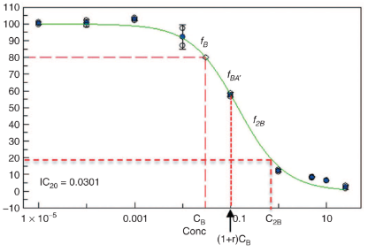
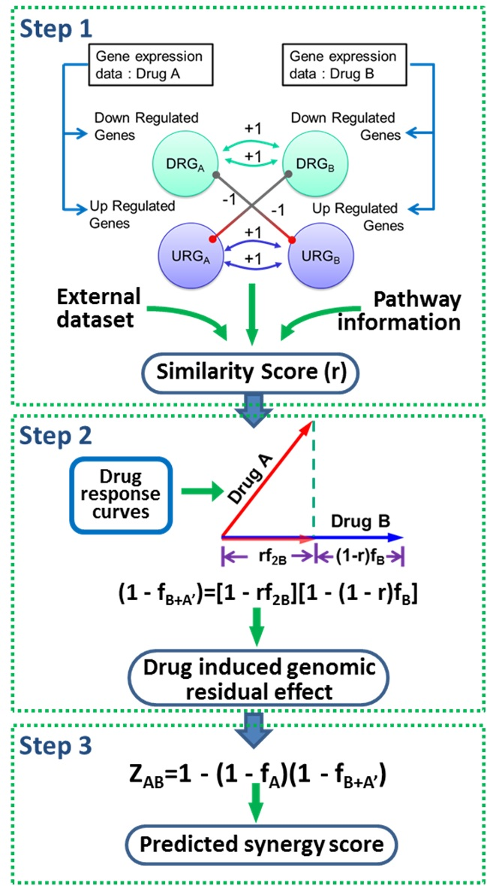
How to quantify the contribution of drug A?
Define a coefficient r that measures the similarity between Comp. A and Comp. B.
Case 1: r = 0, A and B are independent
Case 2: r = 1, A and B are same
Case 3: 0 < r < 1
1 - f_{B+A’} = 1 - f_{B}
Independent
1 - f_{B+A’} = 1 – f_{2B}
Same drug
We proposed a similarity score r to estimate the middle phase.
Notes:
To quantify this, we first exam two extreme case: first, if drug A has no contribution to drug B, in that case, A + B equal B, so we can read the effect of combination of the DRC of B
Second, if the drug A is same as drug B, then the combination is 2B, we can also read the effect from dose response curve.
To estimate the middle phase, we propose this formula. R is the similarity score to of two drugs to give different weight to these two case.

Slide 15
Estimating A + B effect
Z_{B+A’} = 1 – (1-f_{A}) [ 1 - r f_{2B} ] [ 1 - ( 1 – r ) f_{B} ]
From A
From similar part of B
From dissimilar part of B
Notes:
How DIGRE work?
Because what we have is the single drug treatment data, so we approximate …
Then the question becomes how to estimate the viability reduction if the cell has already been treat …
We have the gene expression profile in baseline and single drug treatment, to use these data, we assume that …
And further we assume that …
Now the question becomes how to quantify the contribution of first drug to the second drug.

Slide 16
The sequencing of treatments matters
Giving chemotherapy first has better overall survival results than giving radiation therapy first (Recht et al, NEJM 1996).
The appropriate sequencing and scheduling of chemotherapeutic agents may overcome some drug resistance. (Manish et al, CCR 2001).
Flavopiridol → Paclitaxel: reduces drug paclitaxel sensitivity
Paclitaxel → Flavopiridol: sequence-dependent synergy
Cisplatin → Paclitaxel: reduces drug paclitaxel sensitivity
Paclitaxel → Cisplatin: sequence-dependent synergy

Slide 17
The overall combination effects
Z_{B+A’} = 1 – (1-f_{A}) [ 1 - r f_{2B} ] [ 1 - ( 1 – r ) f_{B} ]
B
B
z =(z_{A}+ z_{B} )/2
A
B
A+B’
Z_{A+B’} = 1 – (1-f_{B}) [ 1 - r f_{2A} ] [ 1 - ( 1 – r ) f_{A} ]

Slide 18
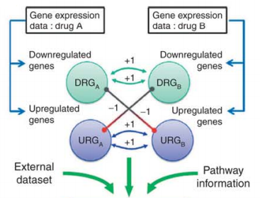
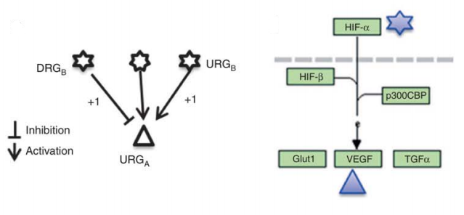
How to compare drug similarity?
Compare the genomic change in 8 cell growth related KEGG pathway (focused view)
Look at the up-stream genes (global view)
aminoacyl-tRNA biosynthesis
MAPK signaling pathway
NF-kappa B signaling pathway
Cell Cycle
p53 signaling pathway
Apoptosis
TGF-beta signaling pathway
Cancer pathway
Similarity score (r)
Notes:
The detail to calculate r is a little complicated and tedious, I’m going to skip this part, the concept is more similar the gene expression profile of this two drug, the bigger the r.

Slide 19
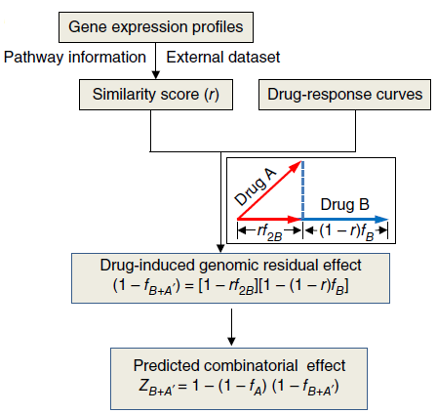
DIGRE workflow and performance
DIGRE workflow
PC-index 0.613
Top rank pairs
Combination | DIGRE Rank | Observed Rank
H-7 & Rapamycin | 1 | 27
H-7 & Monastrol | 2 | 14
H-7 & Mitomycin C | 3 | 2
H-7 & Trichostatin A | 4 | 19
Etoposide & Mitomycin C | 5 | 3
Methotrexate & Mitomycin C | 6 | 28
Camptothecin & Mitomycin C | 7 | 5
Blebbistatin & H-7 | 8 | 7
Etoposide & H-7 | 9 | 6
Camptothecin & Methotrexate | 10 | 62
Doxorubicin & Mitomycin C | 11 | 4
Camptothecin & H-7 | 12 | 10
H-7 & Vincristine | 13 | 43
Camptothecin & Etoposide | 14 | 15
Etoposide & Methotrexate | 15 | 76
Notes:
1. This the top predicted pairs and their real rank. We can see most top rank are validated synergistic pairs.

Slide 20
Update KEGG pathway information
Gene-gene interaction dose affect drug synergy
Original KEGG Pathway
CGP pathway
Updated KEGG Pathway
CGP pathway
1537 activations
645 inhibitions
835 genes
GP pathway
2539 genes
4492 activations
1713 inhibitions
932 genes
1651 activations
736 inhibitions
GP pathway
2709 genes
6898 activations
1399 inhibitions
PC-index: 0.613
PC-index: 0.617

Slide 21
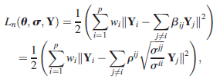

Construct gene network
KEGG is incomplete and not context-specific
Reverse engineering approach to construct gene network
Data: gene co-expression data
GSE10846 expression data (DLBCL: diffuse large B-cell lymphoma)
414 samples and 54,614 probes (21,050 genes)
Methods: Sparse Partial Correlation Estimation (SPACE)
Method | PC-Index
Original KEGG | 0.614
Updated KEGG | 0.617
SPACE network | 0.627
Notes:
As we can see though DIGRE is the best performed model, its PC-index is not very high. We want to further improve it.
One key component in the model is the gene-gene interaction information, before we use the KEGG pathway information. KEGG is empirical collected database, it’s not complete and not content-specific.
Because the DREAM data is generated in B-cell lymphoma cell line, so we wonder if we can improve the model by constructing content-specific gene network using co-expression data.
We used both marginal and partial correlation algorithm to … as we expected, the PC-index increased. Though not very impressive, but at least, it confirms that the gene regulatory network do plays a role in drug synergy.
Another thing I can think about is we need better knowledge to link the genomic change to cell growth phenotype. CRISPR screening is a potential resource we can use. Because it’s a direct measure of contribution of each gene to the cell growth.

Slide 22
Biological Validation detail motivation lung cancer drug selection cell line
Selected 33 compounds for dose response curve and transcriptome data.
9 FDA approved, 13 in clinical trials (6 in phase III, 6 in phase II, 1 in phase I) and 11 in preclinical research.
Compound | Target | Pathway | Compound | Target | Pathway
Pemetrexed | DHFR | Cytotoxic Drugs | RO-3306 | CDK1/2 | Cell Cycle
Cisplatin | DNA |  | VX-680 (Tozasertib, MK-0457) | AURK
Paclitaxel | Microtubule |  | MK-8776 (SCH 900776) | CHK1 | DNA Damage & Repair
Irinotecan | TOP I |  | VE-821 | ATR
Etoposide | TOP II |  | NU7441 | DNAPK
Erlotinib | EGFR | Membrane Receptor Kinase | Olaparib | PARP
Linsitinib (OSI-906) | IGFR |  | ABT-263 | BCL-2, BCL-XL | Apoptosis
AZD4547 | FGFR |  | Birinapant | IAP
Crizotinib | ALK |  | Bortezomib | Protesome | Ubiquitin/Proteasome
Pictilisib(GDC-0941) | PI3K | PI3K-AKT-mTOR pathway | Entinostat | HDAC | Epigenetic Modification
MK-2206 2HCl | AKT |  | EX-527 | SIRT1
AZD8055 | mTOR |  | STA-9090 | HSP90 | Cytoskeletal Signaling
PF-562271 | FAK | Angiogenesis | FDI-6 | FOXM1 | Transcription Factor
FTI 277 HCl | FNTA | MAPK pathway | Troglitazone | PPAR-γ | Nuclear Hormone Receptor
TAK-632 | B-RAF |  | T0901317 | LXR
Selumetinib(AZD6244) | MEK |  | GSK2194069 | FASN | Fatty Acid Metabolism
 |  |  | Indisulam | RBM93 | Splicing factor

Slide 23
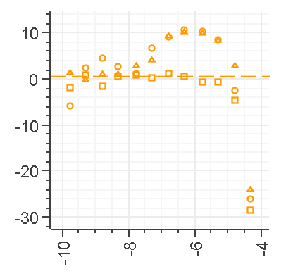
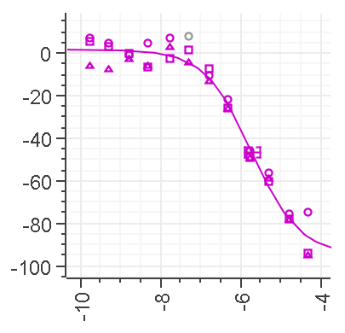
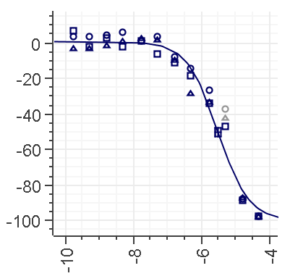
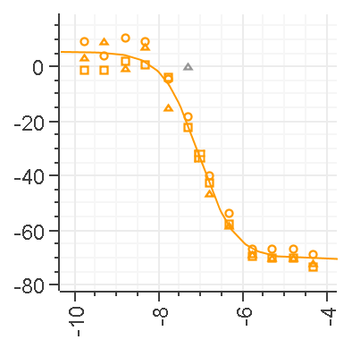
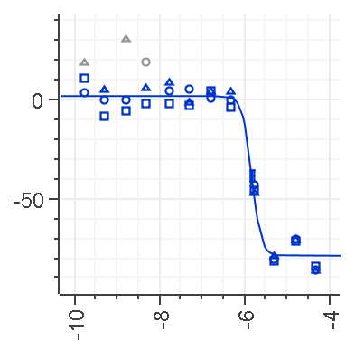
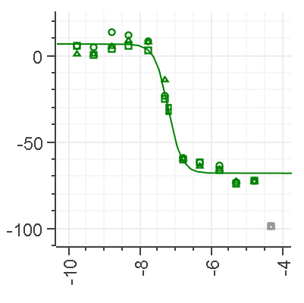
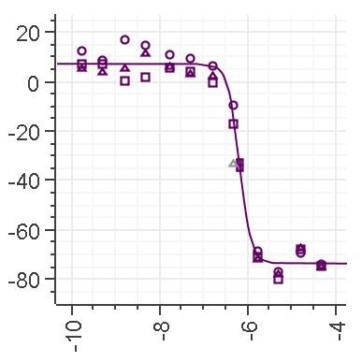
Dose-response data
Cell line:
H1155: non-small cell lung cancer
Dose-response curve:
12 points started from top dose of 50 uM.
Assay 96h after drug addition
H1155 are sensitive to most drugs, except for FASN inhibitor
PI3K/mTOR inhibitors have small Hill coefficient
CDK, DNA repair inhibitos have limited maximum effect
GSK2194069
Pictilisib
MK-2206
AZD8055
RO-3306
VX-680
MK-8776

Slide 24
RNA-Seq data
Collect total RNA 24h following drug treatment at IC₂₀
NextSeq 550, SE-80, 400 million reads per flow cell, single ends
STAR alignment & HTseq count reads
Calculate RPKM, and log transform
Normalize by DMSO control

Slide 25
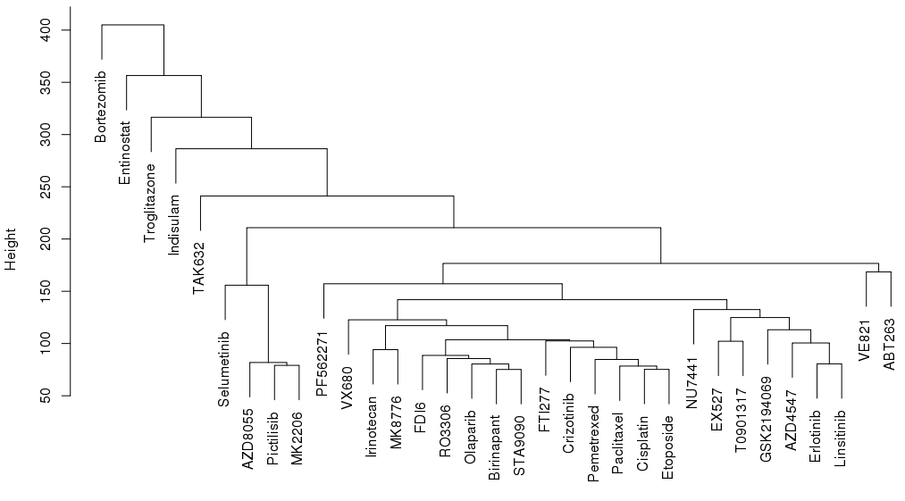
Gene expression profile clustering
PI3K/Akt/mTOR pathway inhibitors
receptor tyrosine kinase inhibitors
cytotoxic drugs

Slide 26
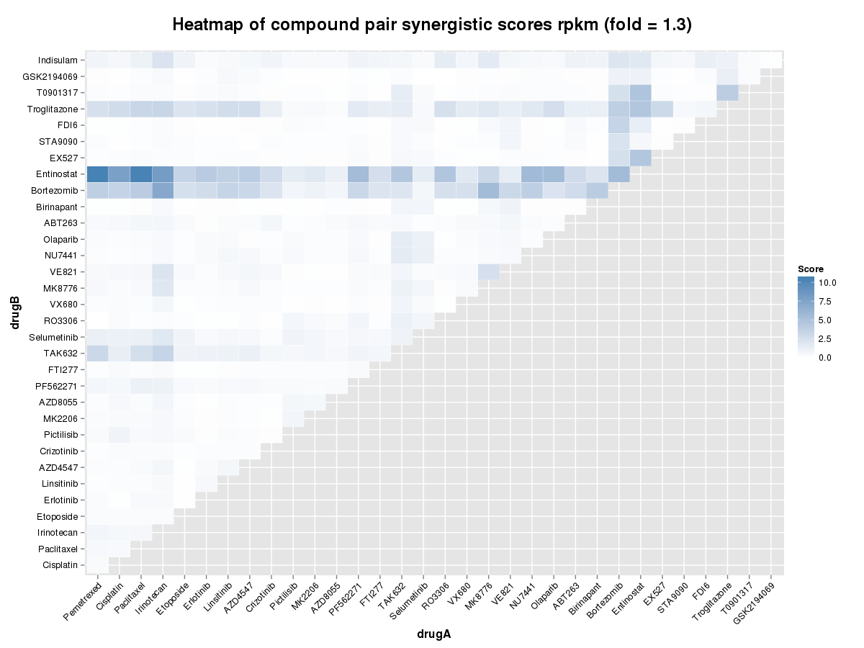
DIGRE analysis future

Slide 27
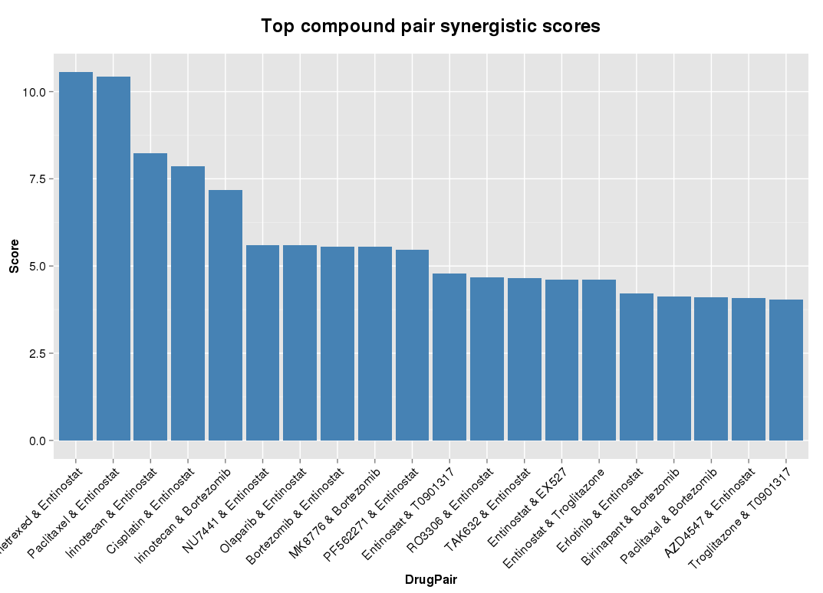
Top ranked pairs

Slide 28
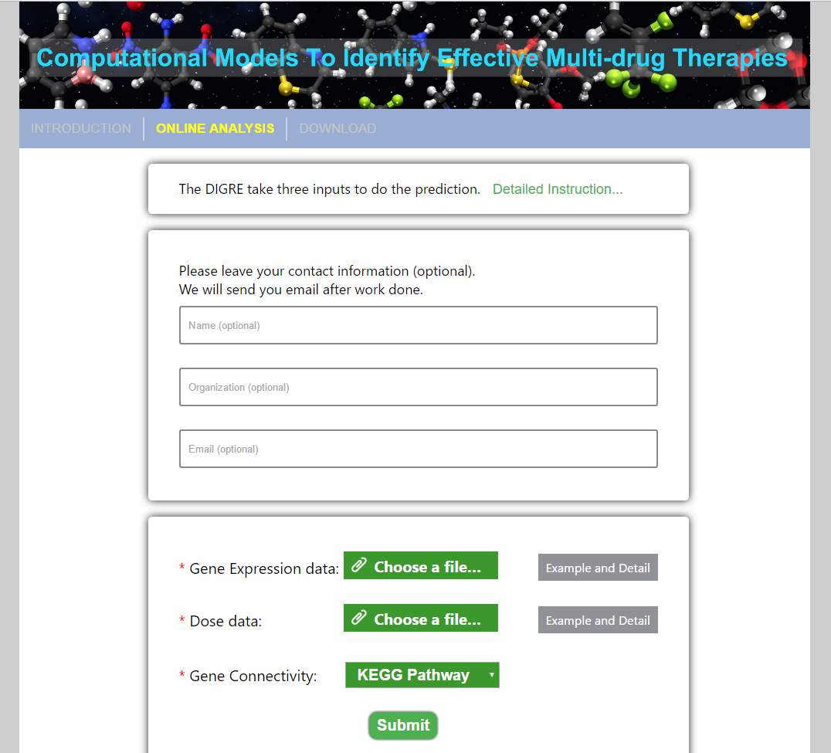
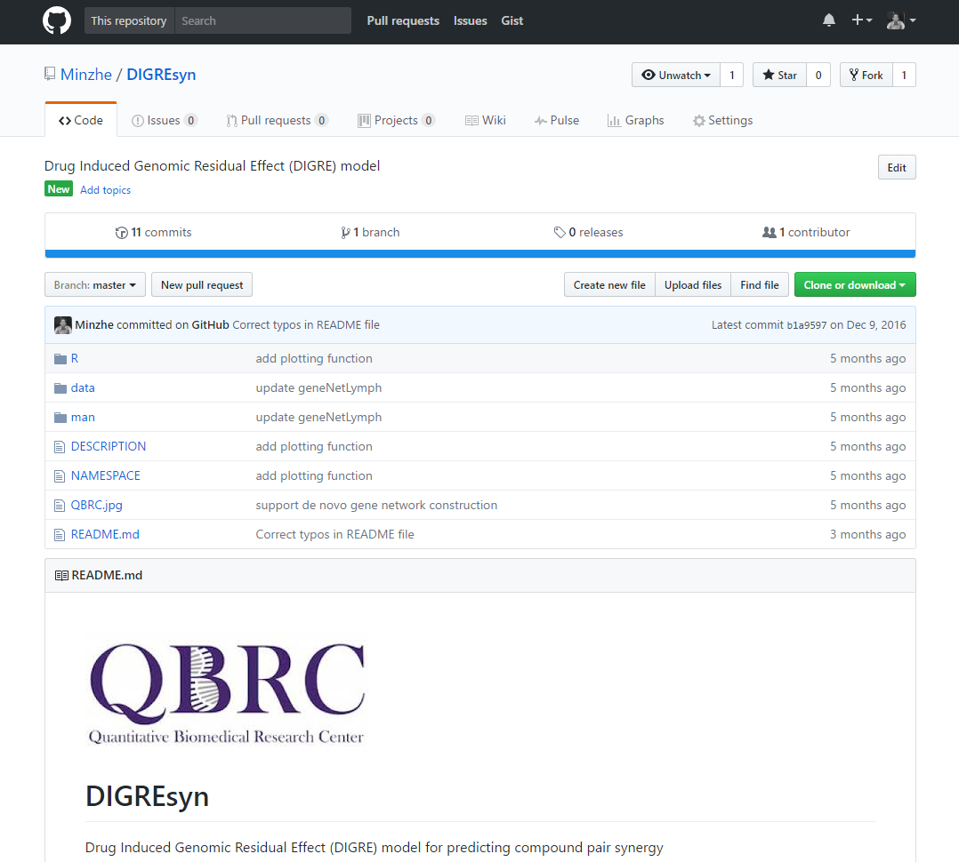
Implementation
Web application
https://qbrc2.swmed.edu/drugcombination/
R package
https://github.com/Minzhe/DIGREsyn

Slide 29
Future plan
Model refine
Incorporate CRISPRi and CRISPRa gene essentiality score to weight genes in transcriptomic change comparison.
Comprehensive comparison of gene network construction methods to have more accurate gene network.
Validate in NCI ALMANAC dataset
NCI ALMANAC (A Large Matrix of Antineoplastic Agent Combinations)
Over 100 small molecule oncology drugs FDA-approved.
Test all possible pairwise combinations (~5000) of these in the NCI-60 panel.
Biological validation
Experimentally test pairwise synergy for validation
Select top ranked pairs with good rationale and possible novel mechanism for futher validation across multiple lung cancer cell lines

Slide 30
Outline
Computational Approach to Predict Multi-Drug Synergistic Effect
Background
IGRE model
Biological validation
Summary and future plan
Bioinformatics Tool to Detect RBP Bound CircRNA in CLIP-Seq Datasets
Background
Motivation
Pipeline
Preliminary results
Future plan

Slide 31
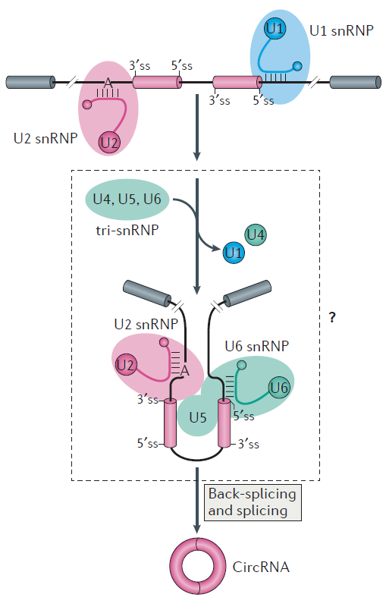
CircRNA formation
Back-splicing circularization
downstream 3’ splice site and upstream 5’ splice site is joined
Chen Ling-Ling. 2016.

Slide 32
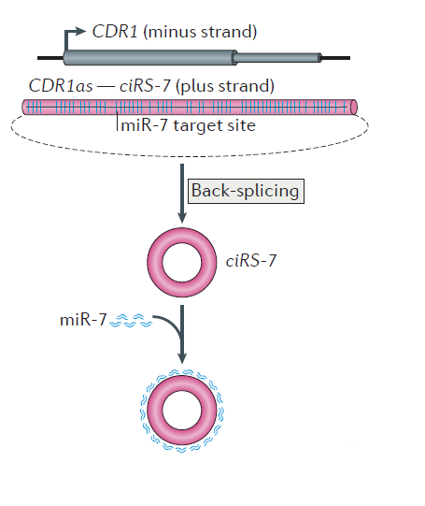
CircRNA function
Function as miRNA sponges
ciRS-7 serves as miRNA sponges
Regulation of transcription
Affect splicing
Chen Ling-Ling. 2016.

Slide 33
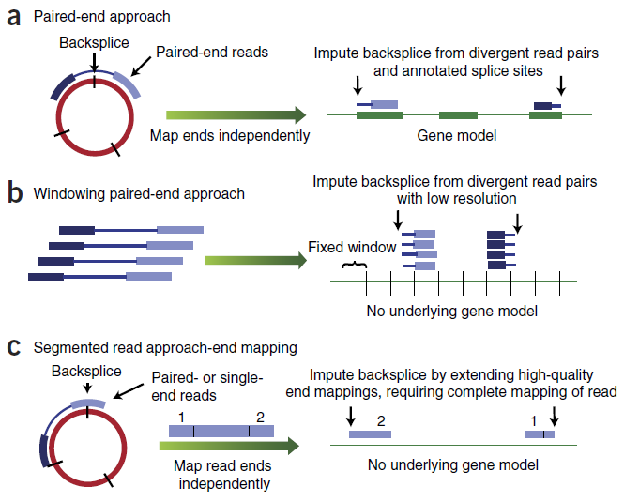
CircRNA detection – genomic methods
Impute backsplice from divergent reads (pair-ends)
Impute backsplice from single reads mapped to two ends (single or pair ends)
Jeck, William R., and Norman E. Sharpless. 2014.

Slide 34
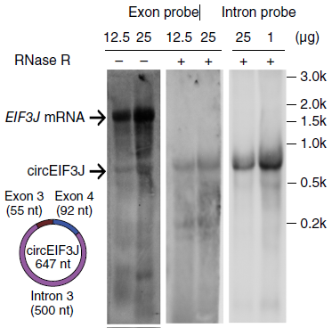
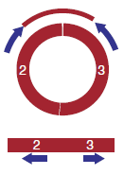
CircRNA detection – biochemical methods
Divergent qPCR primer
RNase R digestion
Li Zhaoyong et al. 2014.

Slide 35
Motivation
To understand the formation and function of circRNA
Important to know the interaction between circRNA and RBP.
Detect circRNA in CLIP-Seq data
CircRNAs are a special type of RNA, CLIP-Seq data should capture their association with RBP

Slide 36
Current bioinformatics tools
All focused on RNA-Seq, cannot be directly applied to CLIP-Seq data
CLIP-Seq has shorter length reads compared to RNA-Seq
CLIP-Seq data is exclusively single-end
CLIP-Seq data has limited library complexity
Gsnap is better choice to align CLIP-Seq data compared to these aligners
Tool | Language | Aligner | Ref
Mapsplice | Python | Bowtie1 | Wang et al., 2010
find_circ | Python | Bowtie2 | Memczak et al., 2013
circRNA_finder | Perl | STAR | Westholm et al, 2014
CIRCexplorer | Python | Bowtie1 and 2 | Zhang et al, 2014
CIRI | Perl | Bwa | Gao et al, 2015

Slide 37
Workflow
Download public CLIP-Seq datasets
Build alignment library
Collect identified circRNA
CLIP-Seq reads
Linear transcript
Linearization of circRNA sequence
Removing PCR duplicates
Build alignment library from combined genome
Competitive alignment
Alignment to circRNA
Alignment to linear transcript

Slide 38
Competitive alignment
CLIP-Seq reads
Mapped to linear transcript
Mapped to linearized circRNA
Mapped to non-junction part
Mapped to across junction
Filtering rules
Overhangs from the junction > 5bp?
Overall mismatch rate < 15%?
Pass both
Fail either one
Alignment to linear transcript
Valid alignments to circRNA
Not a valid alignment

Slide 39
Filtering
To reduce false positive discovery, only keep circRNA:
that have ≥ 2 CLIP-Seq reads mapped across junction.
with at least 20 nucleotides covered at one junction–spanning reads.
with number of unique mapping start position and end position greater than 1/3 of the total number of reads mapped across this junction.

Slide 40
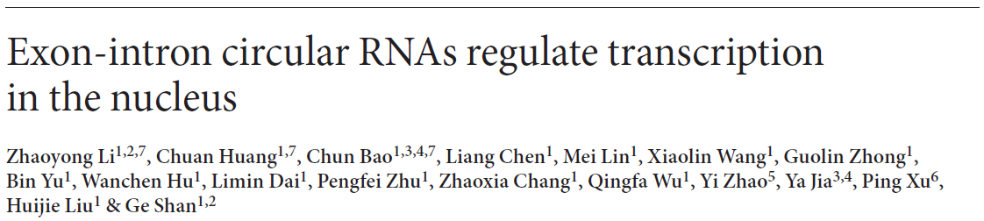
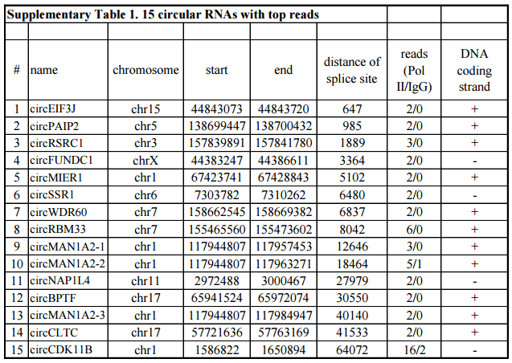
Preliminary validation
circRNA name | Chromosome | Start | End | Strand | # supporting reads
circEIF3J | chr15 | 44843074 | 44843720 | + | 2
circPAIP2 | chr5 | 138699448 | 138700432 | + | 2
circRSRC1 | chr3 | 157839892 | 157841780 | + | 3
circFUNDC1 | chrX | 44383248 | 44386611 | - | 3
circMIER1 | chr1 | 67423742 | 67428843 | + | 3
circSSR1 | chr6 | 7303783 | 7310262 | - | 2
circWDR60 | chr7 | 158662546 | 158669382 | + | 3
circRBM33 | chr7 | 155465561 | 155473602 | + | 12
circMAN1A2-1 | chr1 | 117944808 | 117957453 | + | 2
circMAN1A2-2 | chr1 | 117944808 | 117963271 | + | 9
circNAP1L4 | chr11 | 2972489 | 3000467 | - | 4
circBPTF | chr17 | 65941525 | 65972074 | + | 2
circMAN1A2-3 | chr1 | 117944808 | 117984947 | + | 2
circCLTC | chr17 | 57721637 | 57763169 | + | 0
circCDK11B | chr1 | 1586823 | 1650894 | - | 49
15 experimentally validated circRNA bound by Pol II
Our pipeline re-identified 14 of these 15 circRNA

Slide 41
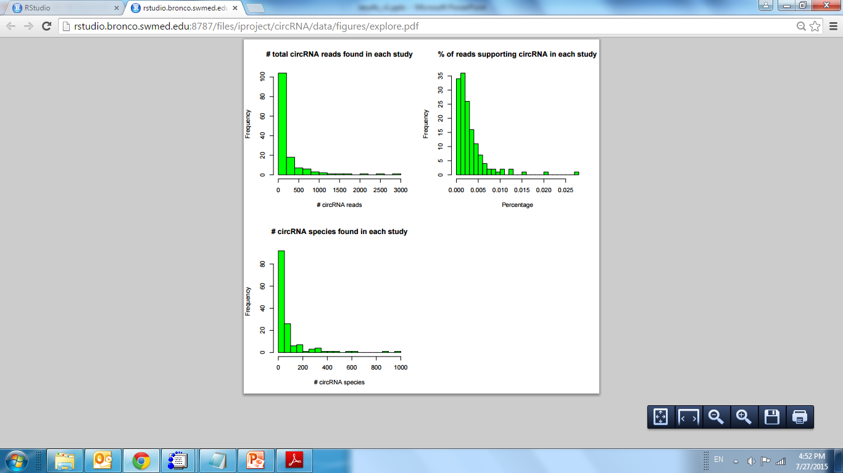
Summary statistics
Percentage of circRNA supporting reads in CLIP-Seq is similar to RNA-Seq

Slide 42
Future plan
Conduct motif search to determine if RBPs bind to circRNA through specific sequence motif recognition
Cluster RBPs based on the similarity of circRNA they binds to find if clustered RBPs share some similar properties.
Functional study to see if the parental genes for circRNA bound by each RBPs are enriched in some certain biological process.

Slide 43
Acknowledgement
Quantitative and Biomedical Research Center
Dr. Yang Xie
Dr. Guanghua Xiao
Dr. Tao Wang
Dr. Sangin Lee (previous)
Dr. Bo Yao
Dr. Yiwei Liu (previous)
Deepak Nijhawan’s lab
Dr. Deepak Nijhawan
Dr. Ting Han
Maria Goralski
John Minna’s lab
Dr. John Minna
Dr. Michael Peyton
High Throughput Screening Core
Dr. Bruce Posner
Melissa McCoy
Genomic and Microarray Core
Dr. Ward Wakeland
Dr. Quan-Zhen Li
Chaoying Liang
George Adam

